Slide 1
Languages
M.Prathilothamai

Slide 2
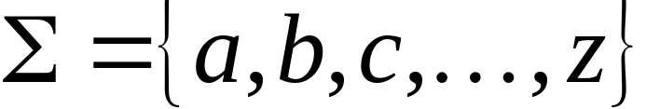
Language: a set of strings
String: a sequence of symbols
from some alphabet
Example:
Strings: cat, dog, house
Language: {cat, dog, house}
Alphabet:
M.Prathilothamai

Slide 3

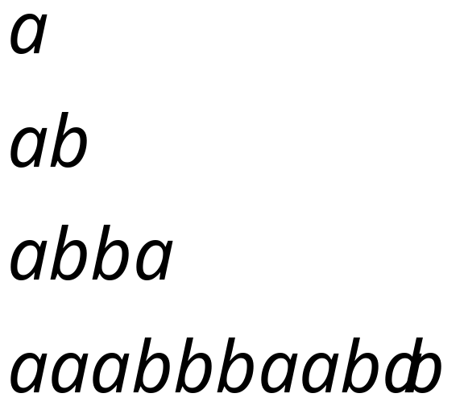
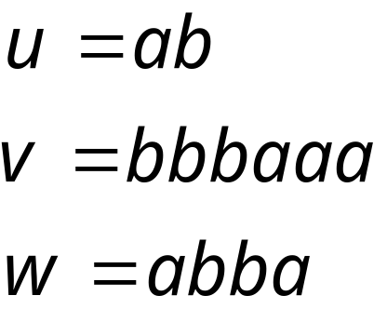
Alphabets and Strings
An alphabet is a set of symbols
Example Alphabet:
A string is a sequence of
symbols from the alphabet
Example Strings
M.Prathilothamai

Slide 4
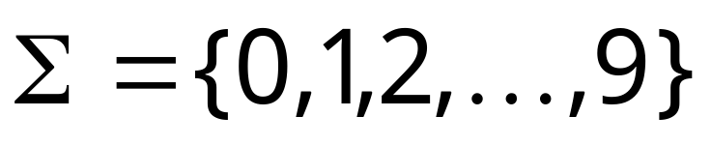
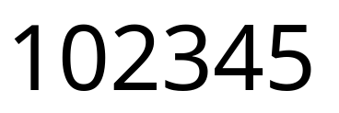
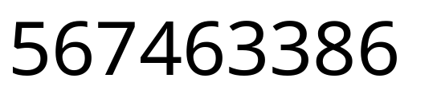
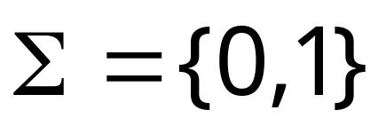


Decimal numbers alphabet
Binary numbers alphabet
M.Prathilothamai

Slide 5
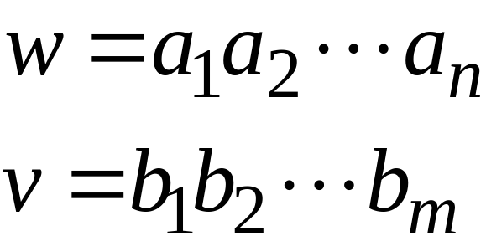
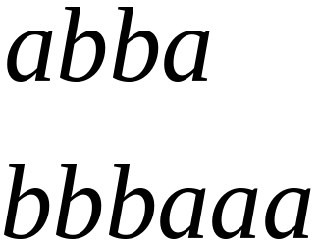
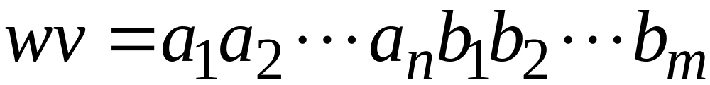

String Operations
Concatenation
M.Prathilothamai

Slide 6




Reverse
M.Prathilothamai

Slide 7


String Length
Length:
Examples:
M.Prathilothamai

Slide 8


Length of Concatenation
Example:
M.Prathilothamai

Slide 9
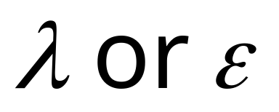
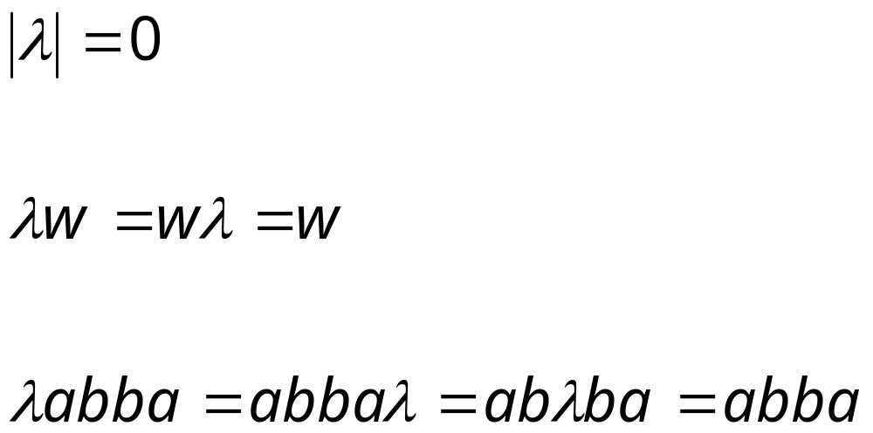
Empty String
A string with no letters is denoted:
Observations:
M.Prathilothamai

Slide 10


Substring
Substring of string:
  a subsequence of consecutive characters
String Substring
M.Prathilothamai

Slide 11




Prefix and Suffix
Prefixes Suffixes
prefix
suffix
M.Prathilothamai

Slide 12




Another Operation
Example:
Definition:
M.Prathilothamai

Slide 13



The * Operation
: the set of all possible strings from
alphabet
M.Prathilothamai

Slide 14


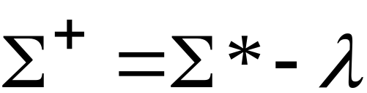
The + Operation
: the set of all possible strings from
alphabet except
M.Prathilothamai

Slide 15


Languages
A language over alphabet
is any subset of
Examples:
Language:
Language:
Language:
M.Prathilothamai

Slide 16
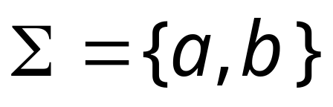




More Language Examples
An infinite language
Alphabet
M.Prathilothamai

Slide 17

Prime numbers
Alphabet
Language:
M.Prathilothamai

Slide 18

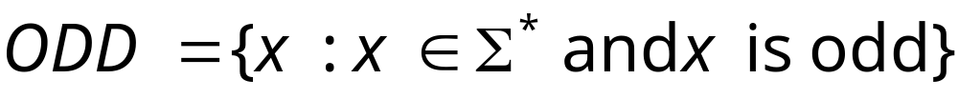

Even and odd numbers
Alphabet
M.Prathilothamai

Slide 19




Note that:
Sets
Set size
Set size
String length
M.Prathilothamai

Slide 20


Operations on Languages
The usual set operations
Complement:
M.Prathilothamai

Slide 21



Reverse
Definition:
Examples:
M.Prathilothamai

Slide 22


Concatenation
Definition:
Example:
M.Prathilothamai

Slide 23



Another Operation
Definition:
Special case:
M.Prathilothamai

Slide 24



M.Prathilothamai

Slide 25



Star-Closure (Kleene *)
All strings that can be constructed from
Definition:
Example:
M.Prathilothamai

Slide 26

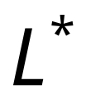


Positive Closure
Definition:
Same with but without the
M.Prathilothamai

Slide 27
Practice Questions
1.Let L = {ab, aa, baa}. Which of the following strings are in L*: abaabaaabaa, aaaabaaaa, baaaaabaaaab, baaaaabaa? Which strings are in L4?
2. Let ∑ = {a, b} and L = {aa, bb}. Use set notation to describe complement of L .
M.Prathilothamai

Slide 28
Conti…
3.Find the languages for ∑ = {a, b} that generate the sets of
all strings with exactly one a.
all strings with at least one a.
all strings with no more than three a’s.
all strings with at least three a’s
4. Let ∑ = {0,1} and L={00,11} find
a. L²
b. L⁴
^{C. L* and L+}
M.Prathilothamai

